Slide 1
Computer Vision with Embedded Machine Learning
Challenges in Computer Vision

Slide 2
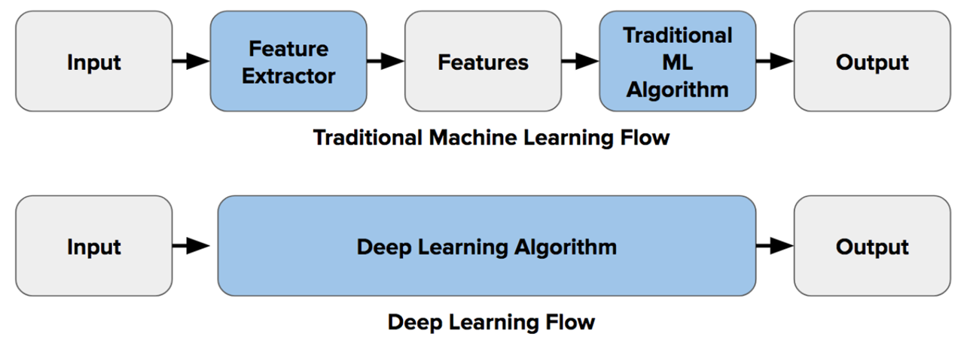
The ImageNet Challenge and the birth of CNNs
Let the computer figure out its own features and how to combine them!

Slide 3
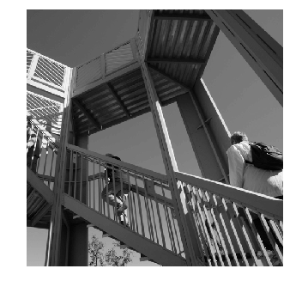
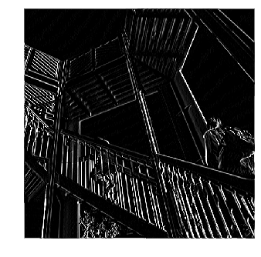
How might we find these features? Convolutions
Colab Link
Features
-1 | 0 | 1
-2 | 0 | 2
-1 | 0 | 1

Slide 4
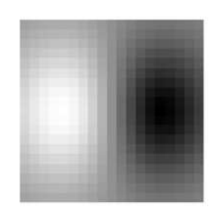
How might we find these features? Convolutions
-1 | 0 | 1
-2 | 0 | 2
-1 | 0 | 1

Slide 5
How might we find these features? Convolutions

Slide 6
How might we find these features? Convolutions

Slide 7
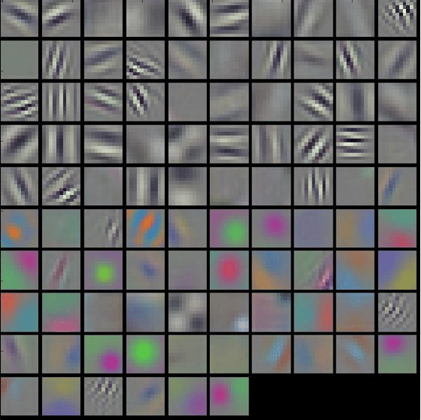
How might we find these features? Convolutions
First Layer Filters Learned by AlexNet

Slide 8

How might we find these features? Convolutions
First Layer Filters Learned by AlexNet

Slide 9
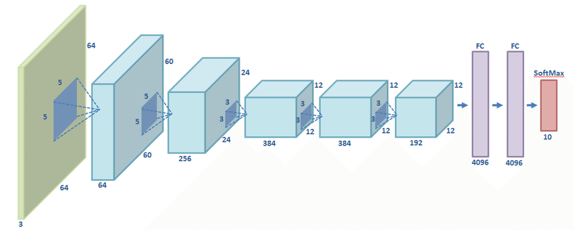
AlexNet
AlexNet Paper
Use convolutions to find features and the summarize them into higher level features
Combine the features to classify the various objects in the dataset

Slide 10
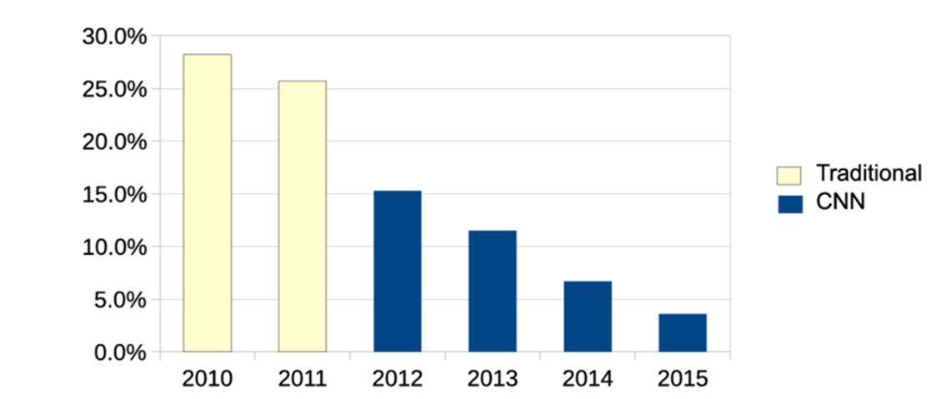
The ImageNet Challenge and the birth of CNNs
https://www.researchgate.net/figure/Historical-top5-error-rate-of-the-annual-winner-of-the-ImageNet-image-classification_fig7_303992986

Slide 11
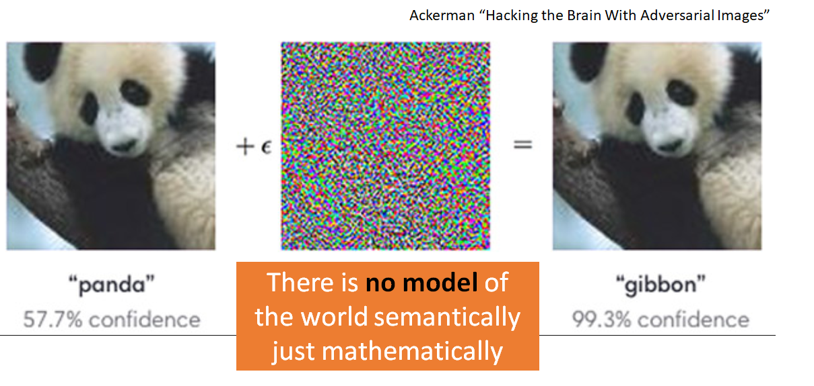
A word of caution...

Slide 12
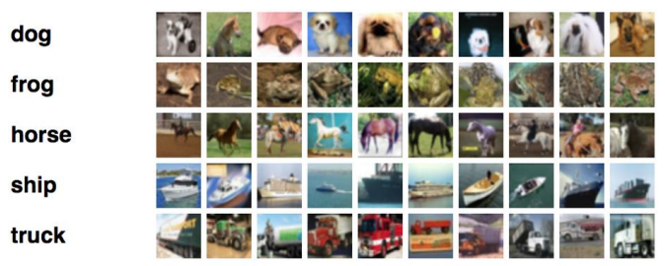
Unmasking Clever Hans predictors and assessing what machines really learn
What might be going wrong?
Train / Test Accuracy
Dogs: 95%
Frogs: 95%
Horse: 95%
Ship: 95%
Truck: 95%
User Accuracy
Dogs: 95%
Frogs: 95%
Horse: 0%
Ship: 95%
Truck: 95%
Fisher vector classifier trained on the PASCAL VOC 2007 image dataset

Slide 13
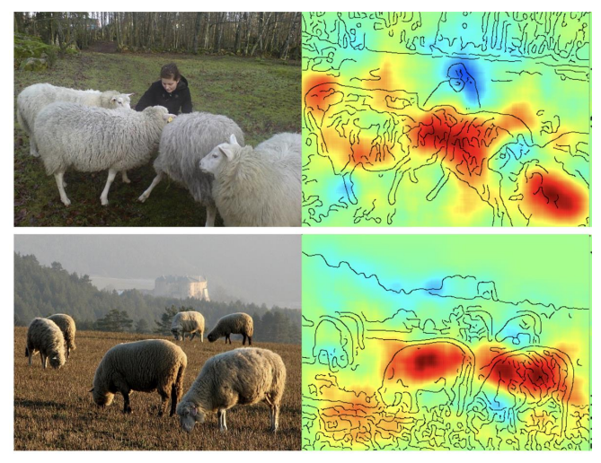
Analyzing Classifiers: Fisher Vectors and Deep Neural Networks
The “sheep-like” parts are in red

Slide 14
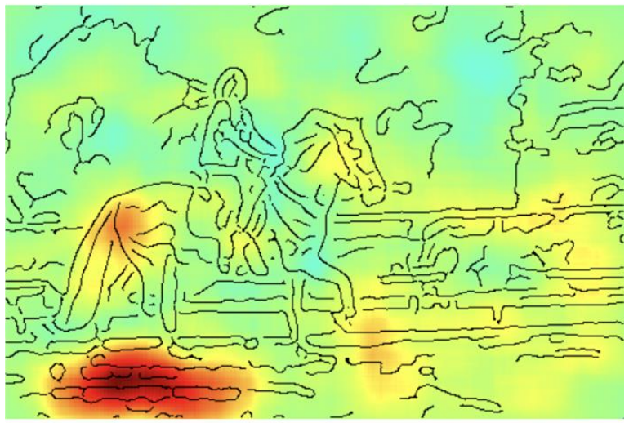
Unmasking Clever Hans predictors and assessing what machines really learn

Slide 15
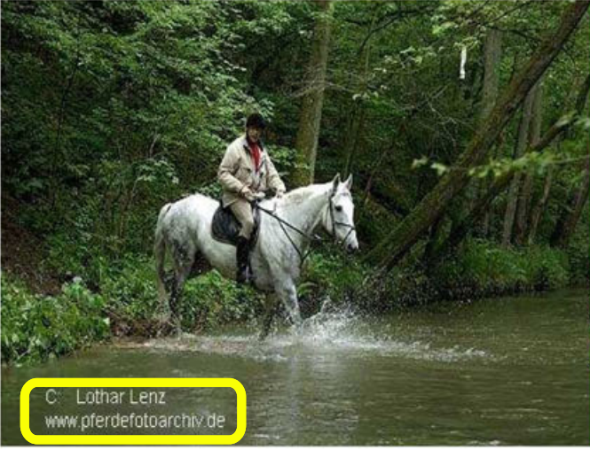
Unmasking Clever Hans predictors and assessing what machines really learn

Slide 16
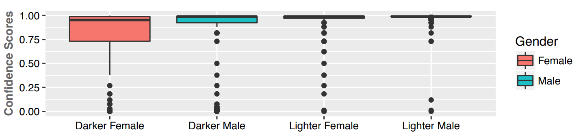
Gender Shades: Intersectional Accuracy Disparities in Commercial Gender Classification

